Slide 1
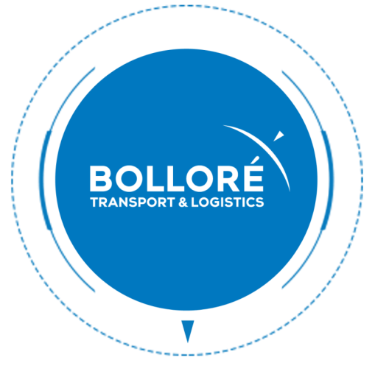

ASPNET CORE Training

Slide 2
Introduction to .NET Core
1
Notes:
We can’t talk about ASP.NET Core without talking about .NET Core

Slide 3
Introduction to .NET Core
What is .NET Core
New Implementation of .NET Framework
Cross platform
Open-source
High performance
Version 3 released on 23/09/2019
.NET 4.8 is the last version of .NET Framework
Notes:
.NET 5 coming in november 2020 will be the next version of .NET Core

Slide 4
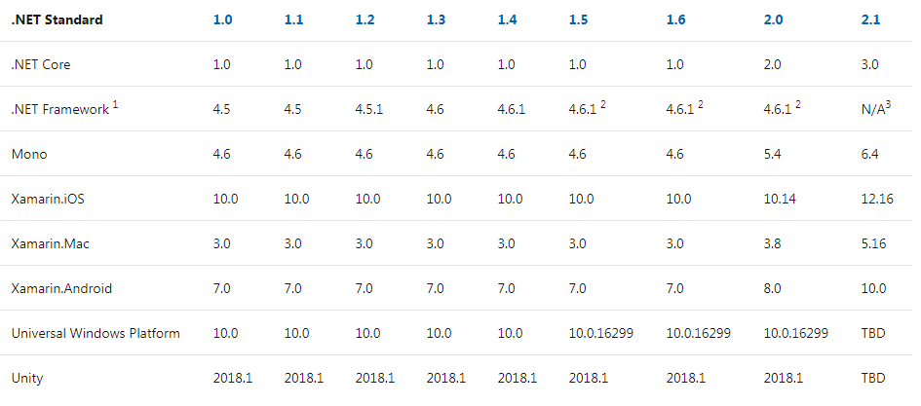
Introduction to .NET Core
.NET Standard
Specification of the .NET API implemented by the frameworks
Notes:
Libraries using only .NET Standard are compatible with all framework implementing the standard
.NET Standard 2.0 contains a lot of the API from .NET Framework. It’s likely that a library using .NET Framework will be compatible with .NET Standard and so will be usable in .NET Core

Slide 5
Introduction to .NET Core
Dotnet cli
Command line tool
Included with .NET Core runtime
dotnet build : Builds source code
dotnet restore : Restore the packages of a project
dotnet run : To execute source code

Slide 6
ASPNET Core Fondamentals
2
Notes:
ASPNET Core is a web framework that can run on .NET Core or .NET Framework (until 2.1)
ASPNET Core was first annonced as ASP.NET MVC 6

Slide 7
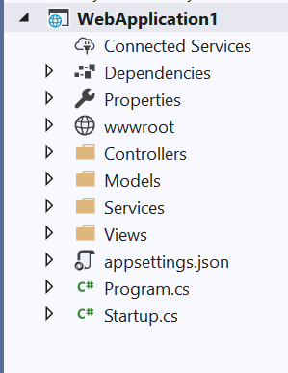
ASPNET Core Fondamentals
Project Folder Structure
wwwroot folder : contains the static files to de deployed with the application
Program.cs : Configuration of the host
Startup.cs : Configuration of the application
No web.config
No Global.asax

Slide 8
ASPNET Core Fondamentals
Project file
Includes :
SDK
Nuget Packages
Projects references
No source file
<Project Sdk="Microsoft.NET.Sdk.Web">
<PropertyGroup>
<TargetFramework>netcoreapp2.2</TargetFramework>
<AspNetCoreHostingModel>InProcess</AspNetCoreHostingModel>
</PropertyGroup>
<ItemGroup>
<PackageReference Include="Microsoft.AspNetCore.App" />
</ItemGroup>
<ItemGroup>
<ProjectReference Include="..\MyLib\MyLib.csproj" />
</ItemGroup>
</Project>
Notes:
An SDK is a set of nuget packages automatically included in a project as well as some MSBUILD directive on how to build the project

Slide 9
ASPNET Core Fondamentals
Deployment
ASP.NET Core application can be hosted on IIS or on Kestrel
.NET Core runtime can be included with the publish
For IIS Hosting
Web.config is generated by the publish
The .NET Core Hosting Runtime is required
Notes:
Kestrel is a web server included with the runtime and can be launched by simply running the application from a console

Slide 10
ASPNET Core Fondamentals
Startup Class
Configuration of the web application
The Startup class declares
The services required by the application
The dependency injection will provide the declared services where they are required
The HTTP request handling pipeline
Notes:
Startup.cs is the most important file in an ASP.NET Core project

Slide 11
ASPNET Core Fondamentals
Configuration
Accessed with the IConfiguration interface
Pairs of Key/Value
By default contains values from
appsettings.json
environment variables
Command line arguments
{
"section1": {
"key1": "value",
"key2": "value"
},
"section2": {
"key1": "value",
"key2": "value"
}
},
IConfiguration configuration;
string value = configuration["section1:key2"];
Notes:
Other configuration providers can be added if we want to add other settings files.
IConfiguration contains the key/values merged from all settings providers.
Appsettings.developpement.json can overide settings in the dev environment.

Slide 12
ASPNET Core Fondamentals
Dependency Injection
Injectable services are declared in the method Startup.ConfigureServices
Service Lifetime :
Transient :
Service is created each time it’s requested
Scoped :
Service is created once per client connection
Singleton :
Service is created only once, the first time it’s requested
Notes:
Services are injected in the constructors

Slide 13
ASPNET Core Fondamentals
Options
Create a class to represent settings of a service
public class DatabaseOptions {
public string ConnexionString { get; set; }
}
Configure the option in startup class
services.Configure<DatabaseOptions>(option =>
option.ConnexionString = Configuration["database:connectionString"]);
Inject the option in the service and not the Configuration
public class MyService : IMyService {
private string connectionString;
public MyService(IOptions<DatabaseOptions> options) {
connectionString = options.Value.ConnexionString;
}
}

Slide 14
ASPNET Core Fondamentals
Middleware
Middlewares are assembled into a pipeline to handle HTTP Requests
Middlewares process request in the order of their declaration
Middleware 1
Middleware 2
Middleware 3
Middleware 4
Request
Create the response
Response
Notes:
Declaration order is important !
Middlewares are used for exemple to log requests, redirect to https, handle authentication, …

Slide 15
ASPNET Core Fondamentals
Host
Program.cs builds and starts the WebHost
On the WebHost we setup
The configuration files
The logging
The web Server
In most cases we will use the default webhost :
WebHost.CreateDefaultBuilder(args)
Notes:
The Host is configured in Program.cs class

Slide 16
ASPNET Core Fondamentals
HttpContext
HttpContext.Current doesn’t exist in ASP.NET Core
We can get the current HttpContext in a service by injection the interface IHttpContextAccessor
The accessor can be added to the service collection with the AddHttpContextAccessor method.
Notes:
HttpContext can be accessed directly from controllers and views
HttpContext is passed as parameters to Middlewares

Slide 17
ASPNET Core Fondamentals
Authentication
Easy way to configure authentication in an application
Authentication schemes are setup in the Startup.cs class
An application can use multiple authentication types
User Identity is a set of claims
Notes:
Require the Middleware app.UseAuthentication();
It’s possible to use multiple authentication schemes in the same application (cookie, token, oauth, …)

Slide 18
ASPNET Core Fondamentals
Authorization
Policies are defined in startup as a set of requirement usually based on claims
We can restrict access to a specified policy with the AuthorizeAttribute
services.AddAuthorization(options =>
{
options.AddPolicy("Administrator",
policy => policy.RequireClaim("IsAdmin", "1"));
});
[Authorize(Policy = "Administrator")]
public class AdminController : ControllerBase
{

Slide 19
ASPNET Core Fondamentals
Logging
Logging providers (including 3rd party loggers) are defined by the Host in Program.cs
Logging is done by injecting ILogger<T> interface in services or controllers
Logs can be filtered
Based on the log level
Based on the namespace
"Logging": {
"LogLevel": {
"Microsoft.AspNetCore.Mvc": "Warning",
"MyApp.Core": "Trace",
"MyApp": "Debug",
"Default": "Error"
}
}
Notes:
Log levels : (Trace, Debug, Info, Warning, Error, Critical)
We can add providers in program.cs
.ConfigureLogging((hostingContext, logging) => { // Requires `using Microsoft.Extensions.Logging;` logging.AddConfiguration(hostingContext.Configuration.GetSection("Logging")); logging.AddConsole(); logging.AddDebug(); logging.AddEventSourceLogger(); })
We can add third party providers
Log filtering can be setup in appsettings.json with the default host builder

Slide 20
ASPNET Core Fondamentals
HTTPClient
HTTPClient objects are not meant to be disposed each time
IHTTPClientFactory will create clients in pools and reuse them
We can inject IHTTPClientFactory in our services or directly inject HTTPClient
services.AddHttpClient();

Slide 21
ASPNET Core Fondamentals
Hosted Services
HostedServices are services run in the background of the application. They are started at the beginning of the application
They are usually done with an infinite loop in the StartAsync method
services.AddHostedService<MyHostedService>();
public class MyHostedService : IHostedService {
public async Task StartAsync(CancellationToken cancellationToken) {
while (true) {
//Do something
}
}
public async Task StopAsync(CancellationToken cancellationToken) {
}
}

Slide 22
ASPNET Core MVC
3

Slide 23
ASPNET Core MVC
Controllers
Class name end with Controller
API Controller class inherits from ControllerBase
MVC Controller class inherits from Controller
Notes:
No more WebAPI
ControllerBase doesn’t handle Views, can be used when the controller is only used for API.

Slide 24
ASPNET Core MVC
Routing
Routing can be setup with RouteAttribute on controller or action
Routes can be setup in the Middleware
[Route("api/[controller]")]
public class DataController : ControllerBase
{
[HttpGet]
[Route("{entityId}")]
public async Task<IActionResult> GetOne(int entityId)
{
…
app.UseMvc(routes =>
{
routes.MapRoute("default", "{controller=Home}/{action=Index}/{id?}");
});

Slide 25
ASPNET Core MVC
Razor View
Views are now compiled into the dll and can no longer be edited directly on a deployed application
We can inject services directly in the views with the @inject razor directive
Razor Views can be included in libraries to be reused accross multiple projects.
@inject IMyService myService
Notes:
We can inject services directly in views with @inject.
For exemple :
@inject IMyService myService

Slide 26
ASPNET Core MVC
Tag Helper
A new HTML like syntax for razor views
Tag helpers are attributes prefixed with asp- that we can use on standard HTML tags
<label asp-for="Login" class="col-md-2">Login</label>
<input asp-for="Login" type="text" name="login" />
<span asp-validation-for="Login" class="text-danger"></span>
<a asp-controller="Home" asp-action="Index">Home</a>
<script src="~/js/site.js" asp-append-version="true"></script>

Slide 27
ASPNET Core MVC
Razor Page
A new way to serve HTML page generated by razor Included in MVC middleware
Easier to make simple web apps than with MVC
A Razor page is a razor cshtml file with the @page directive, and a class inheriting from PageModel
No controller, request are handled by the page model

Slide 28
ASPNET Core MVC
Bundle
No more out of the box bundling/minification of static assets. Usually bundling/ minification is done in the client side build pipeline
We can add bundling at build time with the package BuildBundlerMinifier
Add a bundleconfig.json to declare the bundles
Include the bundled files in razor views with the environment tag helper
<environment include="Development">
<script src="~/js/site.js" ></script>
</environment>
<environment exclude="Development">
<script src="~/js/site.min.js" asp-append-version="true"></script>
</environment>

Slide 29
ASPNET Core MVC
SignalR
Hubs are declared in startup
Strongly Typed hubs let us declare the methods we can call on clients
We can call methods on clients from services and controllers by injecting IHubContext
public interface IHubMessage {
Task GetNewMessage(MessageModel message);
}
public class MessageHub : Hub<IHubMessage> {
}
private readonly IHubContext<MessageHub, IHubMessage> _hubContext;
public async Task SendMessage(MessageModel message) {
await _hubContext.Clients.All.GetNewMessage(message);
}
Notes:
SignalR Core is included with ASP.NET Core

